Slide 1
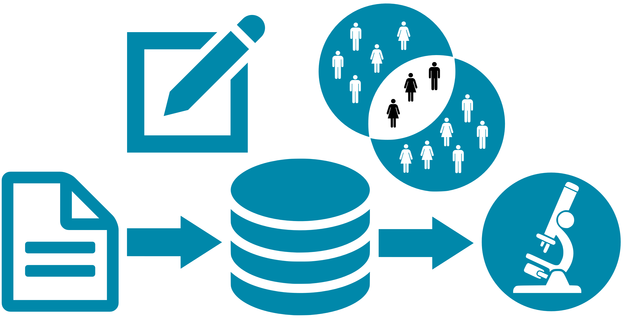
RDMP
High Level Overview

Slide 2

Tayside Only
Creatinine
Biochemistry

Slide 3
Tayside Only
Creatinine
Biochemistry
HBA1 C

Slide 4
Tayside Only
HBA1 C
Creatinine
Biochemistry

Slide 5
Tayside Only
HBA1 C
HBA1 C
Creatinine
Creatinine
Biochemistry
Biochemistry
ECLS Cohort 1

Slide 6
Tayside Only
HBA1 C
Creatinine
Biochemistry
ECLS Cohort 1
Biochemistry
HBA1 C
Creatinine

Slide 7
D-Dimmer
D-Dimmer
Haematology
Haematology
Tayside Only
HBA1 C
Creatinine
Biochemistry
ECLS Cohort 1
Biochemistry
HBA1 C
Creatinine

Slide 8
D-Dimmer
Haematology
Tayside Only
HBA1 C
Creatinine
Biochemistry
ECLS Cohort 1
Biochemistry
Haematology
HBA1 C
Creatinine
D-Dimer

Slide 9
D-Dimmer
Haematology
ECLS Project
Tayside Only
HBA1 C
Creatinine
Biochemistry
Biochemistry
ECLS Cohort 1
ECLS Cohort 1

Slide 10
D-Dimmer
Haematology
ECLS Project
ECLS Cohort 1
Biochemistry
Tayside Only
HBA1 C
Creatinine
Biochemistry
ECLS Cohort 1

Slide 11

D-Dimmer
Haematology
ECLS Project
Tayside Only
HBA1 C
Creatinine
Biochemistry
ECLS Cohort 1

Slide 12
TARDIS
A&E Diagnosis
Thenmalar
CHI Edris Proj
A&E Drugs
Stroke
DQUIP 2017
SHARE
GRO_Deaths
Genomics Db
ECLS Project
SCI Diabetes RCT
Hospital Admissions
Demography
Haematology
ECLS Project
Share Custom Extract
Retinopathy Study
Ward Data
Biochemistry
ECLS Cohort 1
Immunology
Diabetes
For Fiona SHARE
ECLS Cohort 2
EPAD Batch 1
SCIDiabetes
Diabetic Retinopathy
EPAD Batch 2
DQUIP
Radiology
DOAC Angus
OOH Feasibility
Collorectal Cancer

Slide 13
TARDIS
A&E Diagnosis
Thenmalar
CHI Edris Proj
A&E Drugs
Stroke
DQUIP 2017
SHARE
GRO_Deaths
Genomics Db
ECLS Project
Hospital Admissions
SCI Diabetes RCT
Demography
Haematology
ECLS Project
Share Custom Extract
Ward Data
Retinopathy Study
Biochemistry
Search
ECLS Cohort 1
Immunology
Diabetes
For Fiona SHARE
ECLS Cohort 2
EPAD Batch 1
SCIDiabetes
Diabetic Retinopathy
EPAD Batch 2
DQUIP
Radiology
DOAC Angus
Collorectal Cancer
OOH Feasibility

Slide 14
TARDIS
A&E Diagnosis
Thenmalar
CHI Edris Proj
A&E Drugs
Stroke
DQUIP 2017
SHARE
GRO_Deaths
Genomics Db
ECLS Project
Hospital Admissions
SCI Diabetes RCT
Demography
Haematology
ECLS Project
Share Custom Extract
Ward Data
Retinopathy Study
Biochemistry
HBA1C
ECLS Cohort 1
Immunology
Diabetes
For Fiona SHARE
ECLS Cohort 2
EPAD Batch 1
SCIDiabetes
Diabetic Retinopathy
EPAD Batch 2
DQUIP
Radiology
DOAC Angus
Collorectal Cancer
OOH Feasibility

Slide 15
TARDIS
A&E Diagnosis
Thenmalar
CHI Edris Proj
A&E Drugs
Stroke
DQUIP 2017
SHARE
GRO_Deaths
Genomics Db
ECLS Project
Hospital Admissions
SCI Diabetes RCT
Demography
Haematology
ECLS Project
Share Custom Extract
Ward Data
Retinopathy Study
Biochemistry
Diabetes
ECLS Cohort 1
Immunology
Diabetes
For Fiona SHARE
ECLS Cohort 2
EPAD Batch 1
SCIDiabetes
Diabetic Retinopathy
EPAD Batch 2
DQUIP
Radiology
DOAC Angus
Collorectal Cancer
OOH Feasibility

Slide 16
TARDIS
A&E Diagnosis
Thenmalar
CHI Edris Proj
A&E Drugs
Stroke
DQUIP 2017
SHARE
GRO_Deaths
Genomics Db
ECLS Project
Hospital Admissions
SCI Diabetes RCT
Demography
Haematology
ECLS Project
Share Custom Extract
Ward Data
Retinopathy Study
Biochemistry
Immunology
ECLS Cohort 1
Diabetes
For Fiona SHARE
ECLS Cohort 2
EPAD Batch 1
SCIDiabetes
Diabetic Retinopathy
EPAD Batch 2
DQUIP
Radiology
DOAC Angus
Collorectal Cancer
OOH Feasibility

Slide 17
HIC Live RDMP Deployment
Catalogues
576
Cohort Queries
221
Final Cohort Lists
397
Projects
175
Extractable
364
Cohort Sets
1260
Extraction Configurations
640
Datasets Selected
4,593
(for extraction in a config)
Project Specific
115
Master Filters
190
Extract Filters
4452
Cohort Set Filters
2324

Slide 18
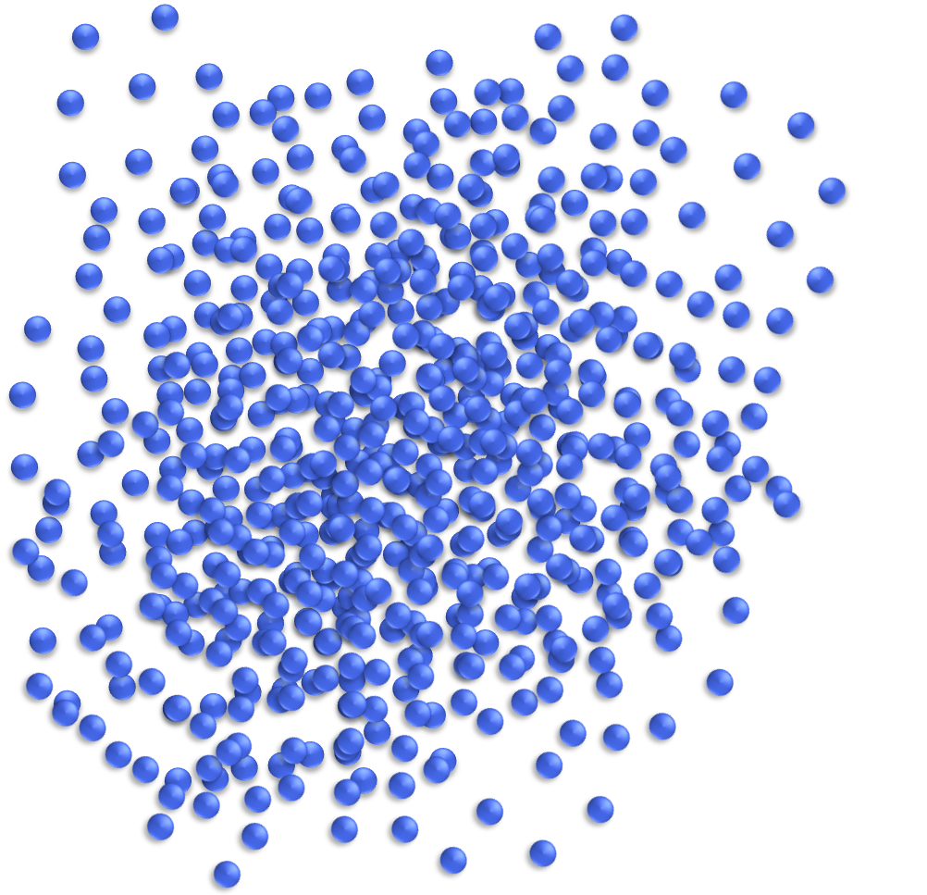
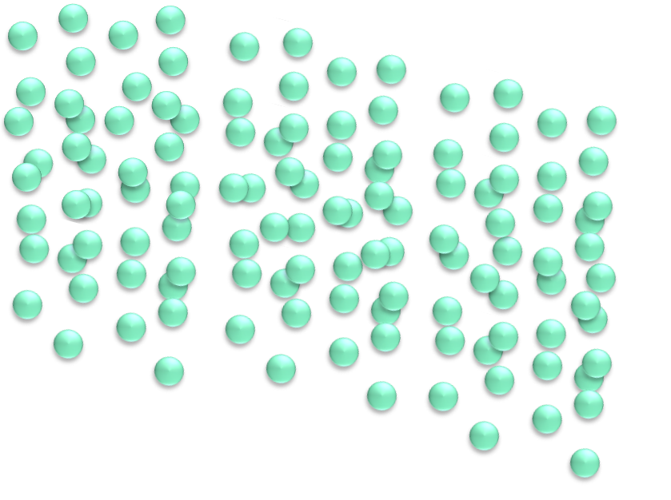



Slide 19
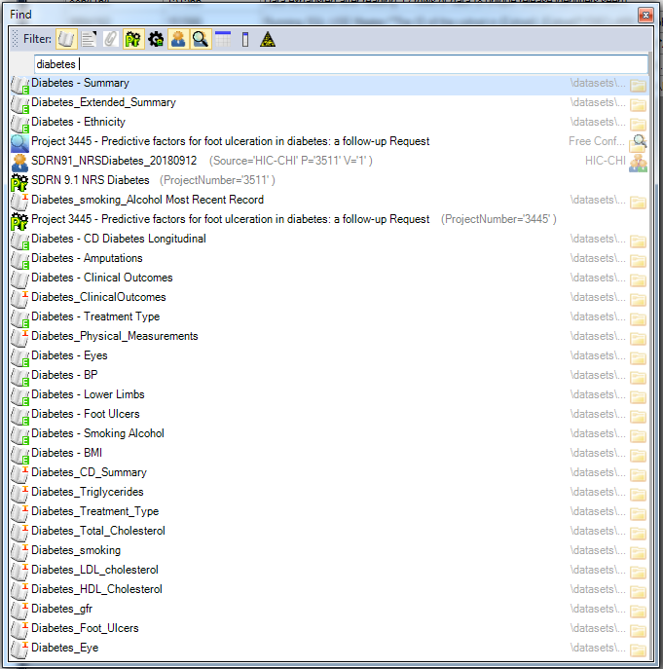
Find
Anything Anywhere

Slide 20
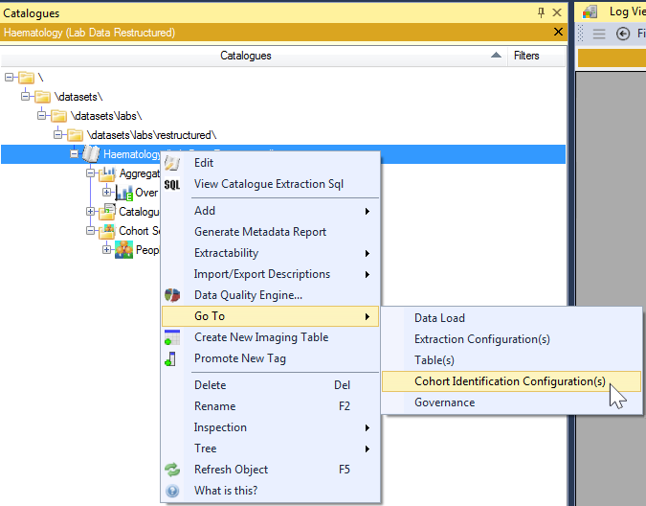
Go To
Usages

